Slide 1

NYC Rent Prices: 2025 Neighborhood Data Analysis
Swipe for comprehensive rent data across all five boroughs

Slide 2
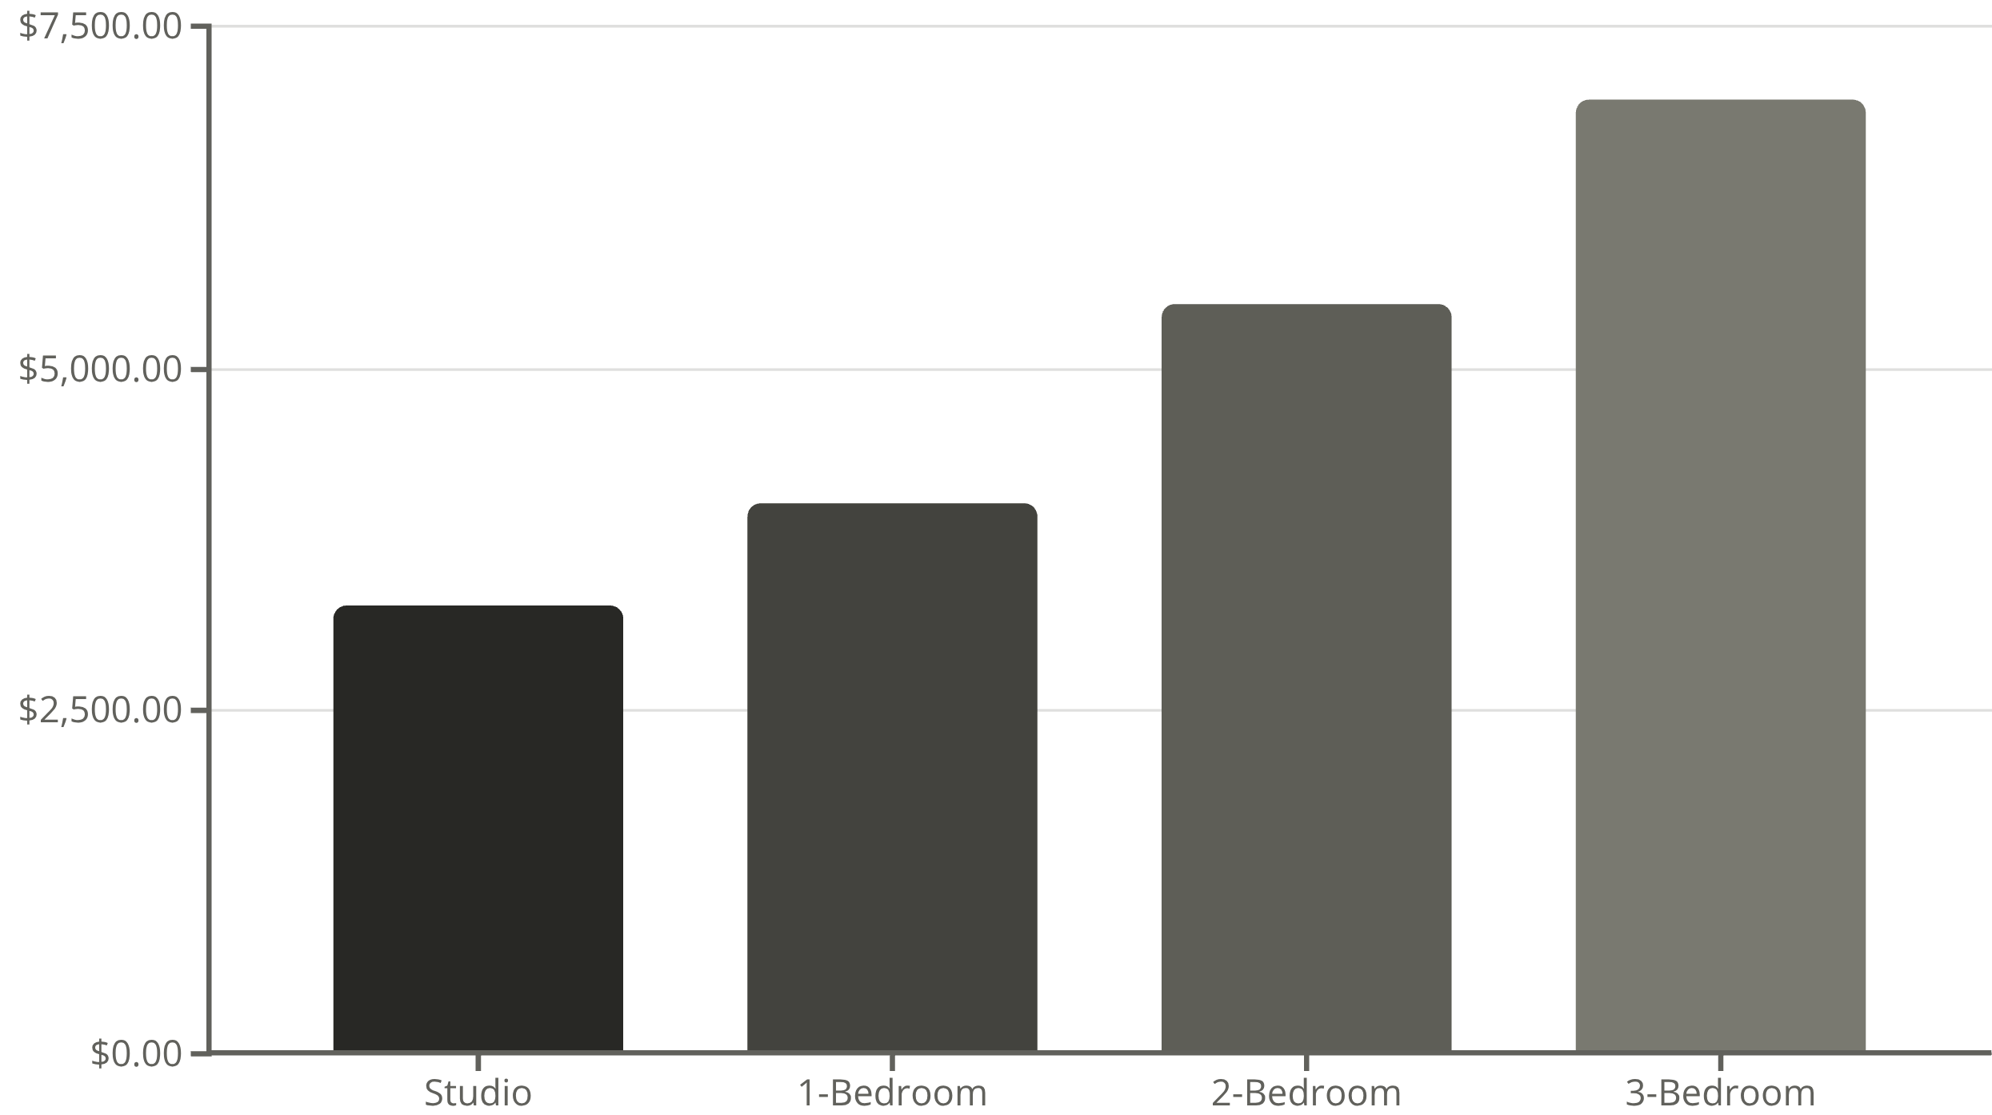
Average Monthly Rent by Apartment Size
2.3%
146%
Year-over-year increase
Above national average
NYC rent prices continue their upward trajectory, with larger apartments commanding premium rates. The market remains significantly elevated compared to national benchmarks.

